Slide 1
Chaos Stones Vol V

Slide 2
Before you watch the Volume ...
The mew threes(based of mew twos)were designed by vaporeon249 (exept hunt)http://vaporeon249.deviantart.com/ is his page.
read top to bottom, left to right.
The mewthree,with reznor was created by psylady her page http://psylady.deviantart.com/.
The lucario and riolu are owned by Elementalheroshadow2 http://elementalheroshadow2.deviantart.com/
And also the new villans(exept supreme underlord red and blackand a giratina bird thing))owned by Monique the cat
Do not own the music!
http://moniquethecat.deviantart.com/

Slide 3
on the last volume
Chaos Stones vol IV

Slide 4
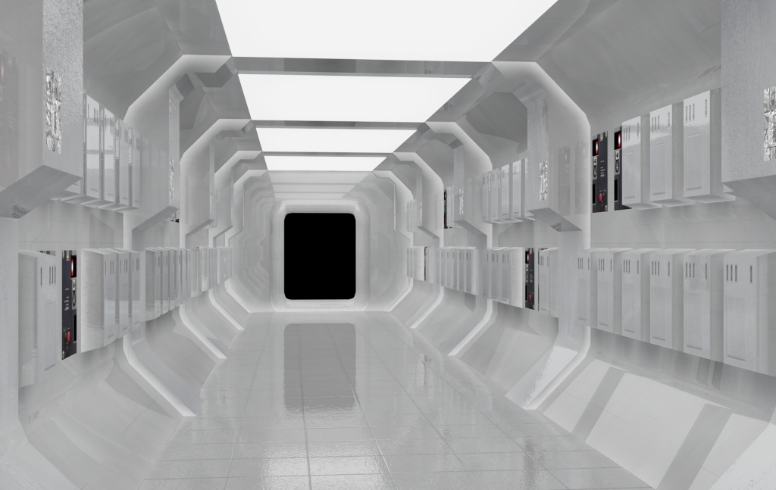
Underlord:Welcome back...where you in the middle of the battleOr did you fail...as usaull!
N:I know they failed under lord...were nearly at the moon(i can finally get my revenge)
Underlord:N how are we going to breath...
N:I made a sheild on us to protect us from the air...and its got a never ending supliy of oxygen

Slide 5
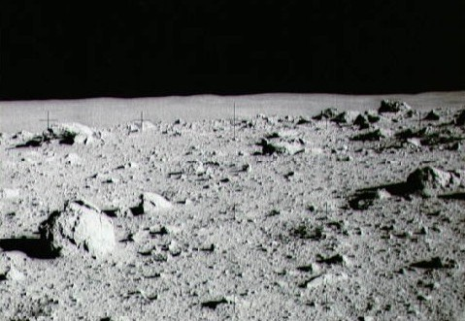
N: i’ll get you Deoxys....
Deoxys:....

Slide 6
Weavile:i geuss you guys knew they were here...ok i’ll tke any of you guys on!
ALL:How about all of together against me...

Slide 7
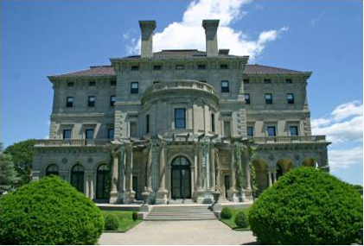
Hunt:were back!!!
Nero:welcome back and you got them both in a day..shall we call the eternal serpant
Hunt:lets do it!

Slide 8
Chapter I

Slide 9
Shadow: shall we make the wish...
Shaman:yes we shall shadow...hunt do the honours
Hunt:eternal dragon!a rise!!

Slide 10
Miloza:what is your wish!(femine voice)
All:we wish for the underlord to beunable to escape his cavern...and same for his minion,and also the volcano city can bew revived!
Miloza:your wish’s has been granted!!farewell

Slide 12
The mewthrees:i geuss its done,buh we feel theirs more to it...it can end like this,wemust finish him in hs lair.elcrtobomb,shadow you two wanna come and join us?
the two:sure
Shadow:if i can i’ll live with u guys in the city with my son of course...them 3 r his friends!

Slide 13
Everyone but the mewthrees,electrobomb and shadow went to the city…will we see them ever again…keep watching each volume to find out!

Slide 14
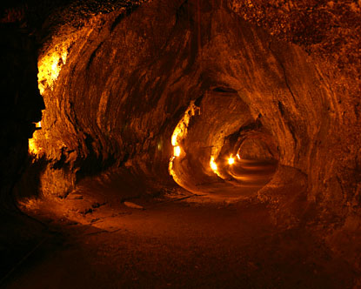
Chapter II
All;who are you two!
We are the supremre underlords

Slide 15
All;are you here to challnge us!
Moniqaue will,

Slide 16
underlord
Monique
Monique ued shadow ball blast super effective!!
Underllord used shadow force
moniqu:e:ill leve you for now....ur enemys are on the way and the will destroy you!!

Slide 17
Supreme underlord:we will wait fo your death...farewell!!

Slide 18
Hunt:Wanna finish this story undrlord...
cordem:To faceundrlord...you will hve to go through us first
Reznor:i’ll go,i’ll go ultra for this!

Slide 19
ultra reznor
Cordem
Ultra reznor used psychic
cordem used shadowball
Ultra reznor used psychic
Cordem used space blast
Energy ULRA PYCHIC!! HIT FOUR TIMES! K.O.

