Slide 1
Chaos Stones vol III

Slide 2
Before you watch the Volume I...
The mew threes(based of mew twos)were designed by vaporeon249 (exept hunt)http://vaporeon249.deviantart.com/ is his page.
read top to bottom, left to right.
The mewthree,with reznor was created by psylady her page http://psylady.deviantart.com/.
The lucario and riolu are owned by Elementalheroshadow2 http://elementalheroshadow2.deviantart.com/
Do not own the music,any of it,its all owned by FUNimantions,

Slide 3
on the last volume
Chaos Stones vol III

Slide 4
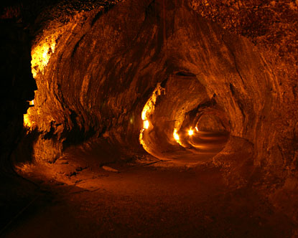
Why are we all gathered here
ALL:to destroy mewblade and her team
We are going into space to find the next 2 chaos stones there,they are hidden on the moon.thunderclap,dhawka i want you two to go occupie mewblade...whle we get into orbit

Slide 5
Welcome back
All:we found three stones
Mewblade:there are 3 more to go...2 are in space on the moon,i remember that mysteryous man talking about then wen i was sleeping
All:and we have found 1

Slide 6
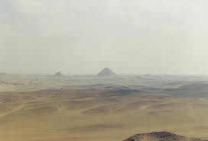
Who are you!!
Shut up old man...i’ll tell you who i am if i want to!! I am the dhawka...i want a battle u emporeor you win and i’ll give u this...

Slide 7
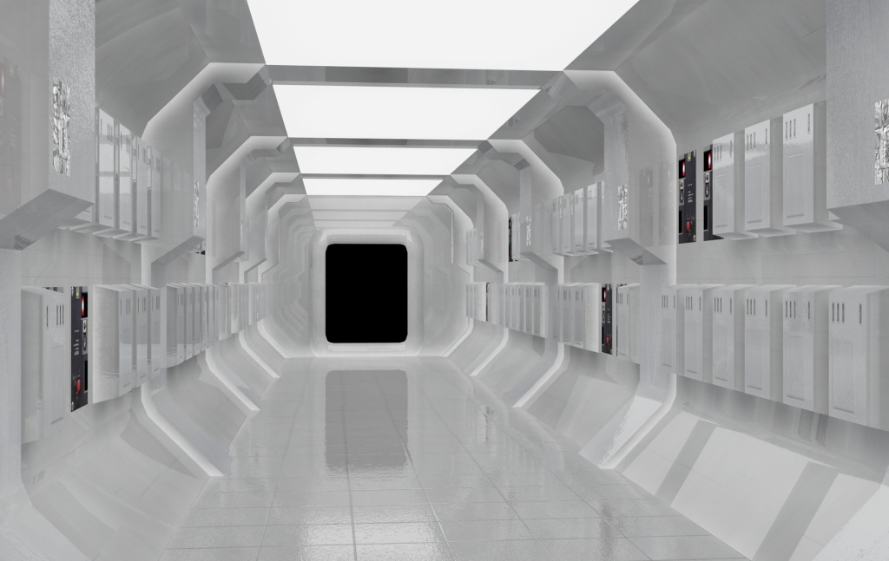
Chapter I
Happy Birthday
V.L.K

Slide 8
Underlord:Welcome back...where you in the middle of the battleOr did you fail...as usaull!
N:I know they failed under lord...were nearly at the moon(i can finally get my revenge)
Underlord:N how are we going to breath...
N:I made a sheild on us to protect us from the air...and its got a never ending supliy of oxygen

Slide 9
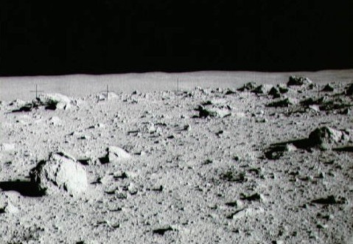
N: i’ll get you Deoxys....
Deoxys:....

Slide 10
Super deoxys
underlord
Super deoxys done super hyper beam...did not effect...
Underlord used shadow force
Super effective
Underlord used shadow force
Super effective
Super deoxys used x scissor

Slide 11
N:you beat him...and you made it so easy...

Slide 12
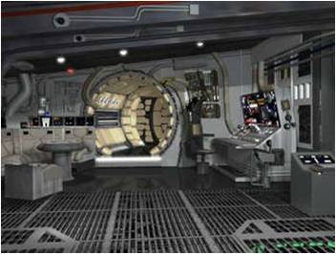
Hunt:do we want to crash...no...uses what ever power you can to stop this ship from heating up...wavile dont bother we dont want you to hurt yourself...if were confronted...you batte not us...and dont worry bout the air...we’ll use our powers to stop the air getting to us and still have oxygen...

Slide 14
Chapter II
Happy Birthday
V.L.K

Slide 15
Weavile:i geuss you guys knew they were here...ok i’ll tke any of you guys on!
ALL:How about all of together against you...

Slide 16
That aint fair
ALL:who are you
Ma names elementalheroshadow2
Buh you could call me shadow and thats ma boy..shadow jr....Feel the power of aura....aura beam...

Slide 17
Shadow:you guys all right
Reznor:Yea were fine...
I’m reznor,the black and red is hunt,the black and purple mewblade...them two are twins...and thats demisewan there sister..with wevile.you were awesone out there...wanna come to earth after weve finished our search?
Shadow:yea sure...wat are you looking for exactly

Slide 18
Hunt:theres these stones 7 actually...there called chaos stones...and with themyou can make a wish...and were tring to keep the underlord down in his lair so he can never escape...
Shadow:so these...i’vethought they we specail rocks..i could tell by there colour but i never knew they could make wishes...

Slide 19
Weavile:i think we can go to earth now!!
Shadow:lets go!

Slide 20
They saw theirs ship..but thought “well find underlords and take his...while he is on the moon we can ake our two wishes” ad so they got to earth...at the mansion...

Slide 21
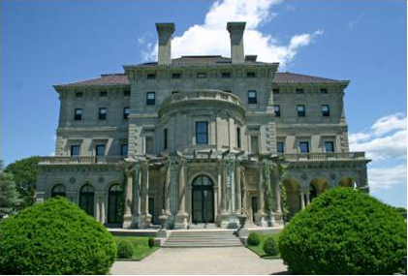
Hunt:were back!!!
Nero:welcome back and you got them both in a day..shall we call the eternal serpant
Happy Birthday
V.L.K
Hunt:lets do it!

Slide 22
Hunt:were back!!!
Nero:welcome back and you got them both in a day..shall we call the eternal serpant
Happy Birthday
V.L.K
Hunt:lets do it!

Slide 23
Thanks for watching Chaos stones vol 4,every volume is two episodes.
You got 7 stones use em...make your wish!!
Happy Birthday
V.L.K

