Slide 1
Chaos Stones vol III

Slide 2
Before you watch the Volume I...
The mew threes(based of mew twos)were designed by vaporeon249 (exept hunt)http://vaporeon249.deviantart.com/ is his page.
read top to bottom, left to right.
The mewthree,with reznor was created by psylady her page http://psylady.deviantart.com/.
Do not own the music,any of it,its all owned by FUNimantions,

Slide 3
on the last volume
Chaos Stones vol II

Slide 4
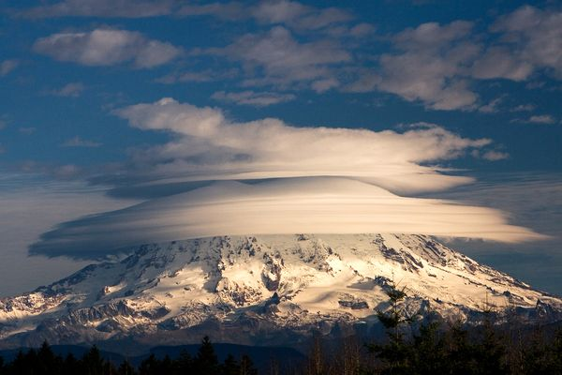

Slide 5
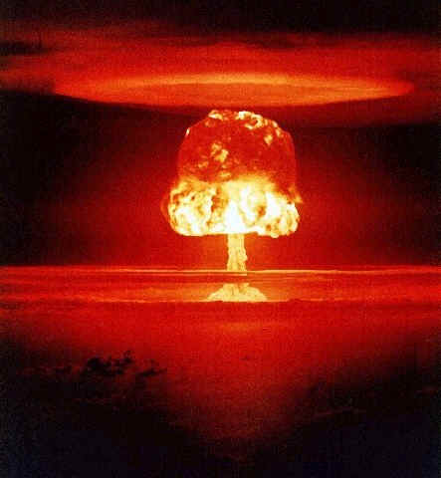
I’ll kill you underlord for making her do this!
Why are you glowing....

Slide 6
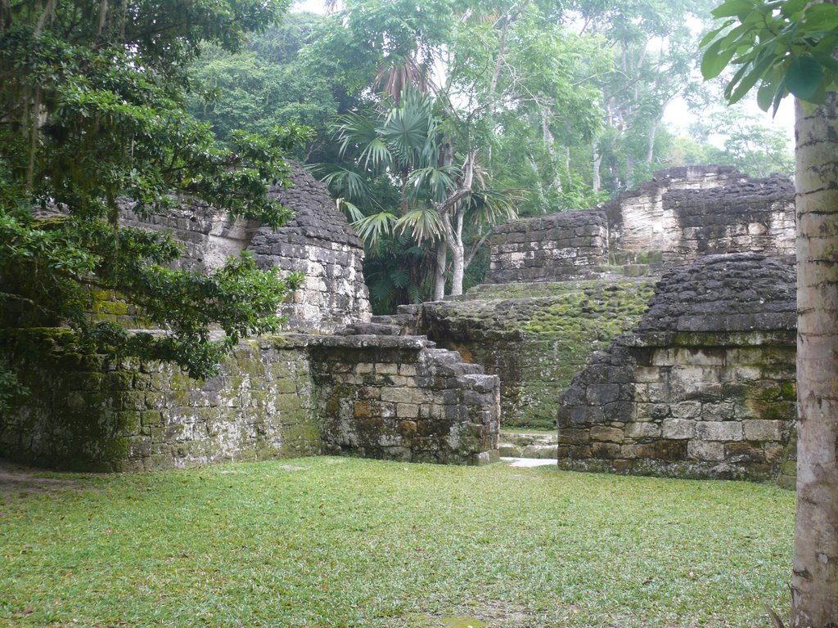
Are you two all right
yea
Look wat fell out of the sky wen you two bout fainted..and wat we found...

Slide 7
Cordem:you won how
Demisewan:i could fell your everymove..i’m phycic..i can hear your weaknesses stregnths everything
all
You can have this...
I thought he worked with underlord...why did he give it

Slide 8
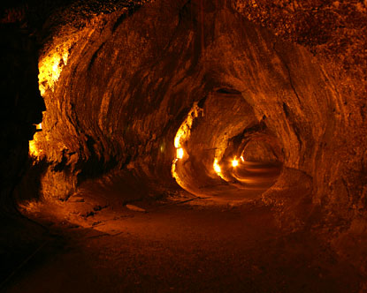
While the gang went to tell the others,the underlord and hs minions all gatherd for a plan...
Chapter I

Slide 9
Why are we all gathered here
ALL:to destroy mewblade and her team
We are going into space to find the next 2 chaos stones there,they are hidden on the moon.thunderclap,dhawka i want you two to go occupie mewblade...whle we get into orbit

Slide 10
Once where in i’ll call you two,use you abilitys to teleport you two me dhawka
Both:got it
Under stood

Slide 11
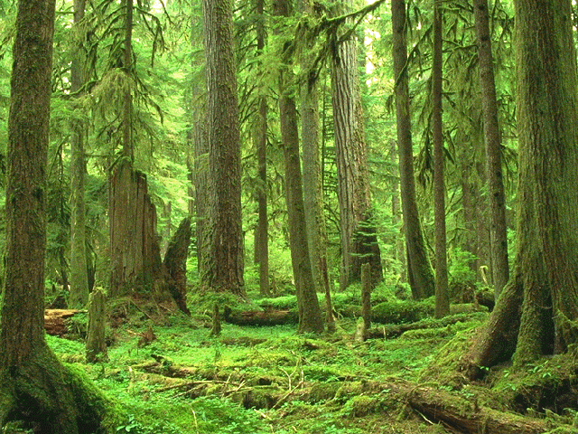
Welcome back
All:we found three stones
Mewblade:there are 3 more to go...2 are in space on the moon,i remember that mysteryous man talking about then wen i was sleeping
All:and we have found 1

Slide 12
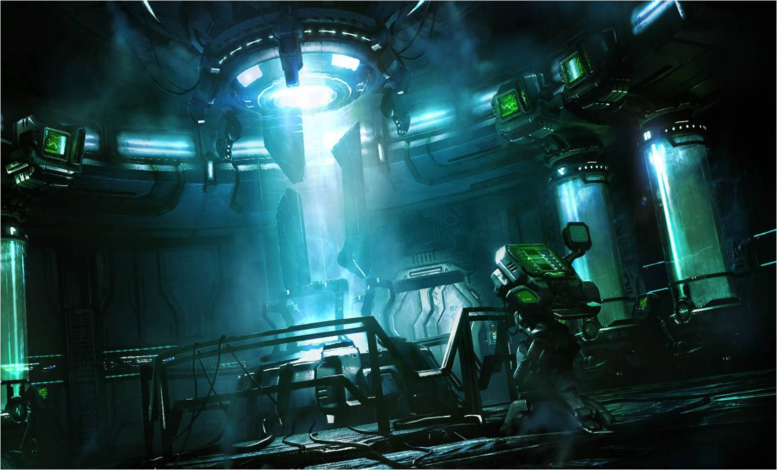
Ah we could find them all.every one...even the ones in space...i shall tell the under lord, and we shall create a weapon to send us into orbit

Slide 13
Well search for the next one then
The purple and white are in space so orange is the one on earth...in the wastelands...us four and wevile will go into orbit...you lot and the kids look for orange in the wasteland
Got it

Slide 14
Who are you
I am thunder clap
Averge minion of the underlord..let us geuss a battle
Yes and you wont survive after me...i want to attle that wevile
Yea he looks weak...
Me..been a long time since ive battled...lets go

Slide 15
Weavile
Thunder clap
Weavie used shadow claw
Thunder clap usedsucker punch
Weavile used lava plume
Thunder clap used ancient power
Weavile used lava plume
KO

Slide 16
I WON!! YES I WON!!
Dont get cocky next time your mine
Ok lets go in to orbit!

Slide 17
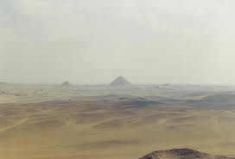
Chapter II

Slide 18
Who are you!!
Shut up old man...i’ll tell you who i am if i want to!! I am the dhawka...i want a battle u emporeor you win and i’ll give u this...

Slide 19
How do you know i was an empoeror
Ever since i was created, I've eased dropped on every one of you...if you lose i get your stones
Fine i’ll battle

Slide 20
Dhawka
laveon
Dhawka used shadow force
Dhawka used shadow force critical
Laveon used hammer arm super effective!!
Laveon used sacred fire
Laveon used sacred fire
Dhawka used shadow force critical

Slide 21
impossible
Been along time since that happened!!
Underlord(were going into orbit)

Slide 22
I geuss the others are going into orbit...
Ok...than...we betterget to the mansion....

Slide 23
Thanks for watching Chaos stones vol 1,every volume is two episodes...and thank you for the veiws you guys!!

