Slide 1
Chaos stones vol I

Slide 2
Before you watch the Volume I...
The mew threes(based of mew twos)were designed by vaporeon249 (exept hunt)http://vaporeon249.deviantart.com/ is his page.
read top to bottom, left to right.
The mewthree,with reznor was created by psylady her page http://psylady.deviantart.com/.
Do not own the music,any of it,its all owned by FUNimantions

Slide 3
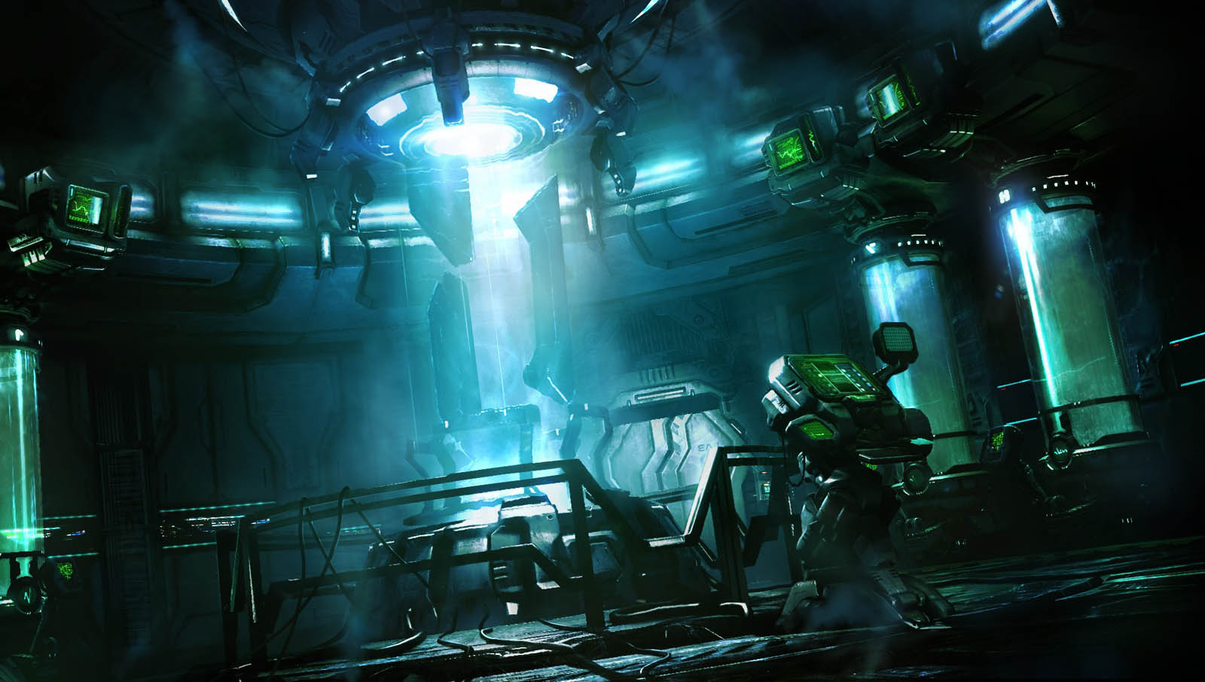
Somewhere in a lab deep below the surface of the
Earth ,a strange being was created for one purpose
This purpose was to destroy its sister and twin brother, demisewan and hunt.
Chapter I

Slide 4
Ah...Mewblade you are finally complete...
After brainwashing you, i can now control all that i have wished for...to destroy demisewan,hunt and the creature that has infected me!

Slide 5
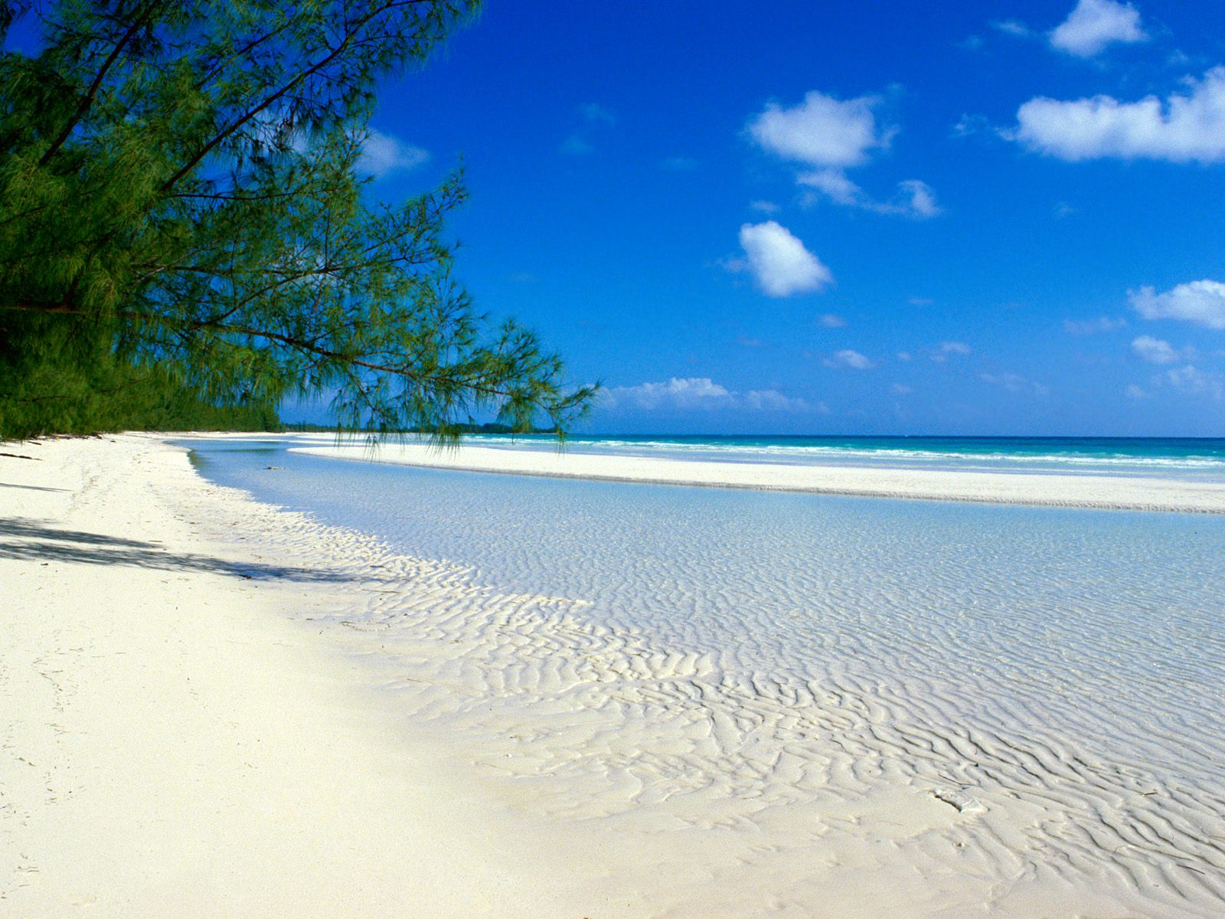
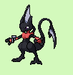
meanwhile
Whats wrong demisewan...
Nothing...just worried about mew blade...
You know mewblade will be able to escape!
I guess your right...*sigh*

Slide 6
Who is this guy demisewan...
Well have to find out

Slide 7
Have a closer look, my brother and sister
What took you so long...
Be quite you fool,i’ll kill you for leaving me behind...
What you on about sis...
Shut up and battle
Demisewan stay out of this if i fall atleast we got you,fly to the mansion

Slide 8
mewblade
hunt
Hunt used psychic
Mewblade used shadowball
Hunt used psychic

Slide 9
Great battle sis...
Shut up fool
Attitude

Slide 10
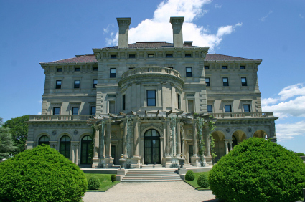
Meawwhile

Slide 11
Hey demisewan
Hey reznor
How was the beach
It wasnt good...mewblade came back,but shes different ,she seemed
That shes been brain washed to kill us,but who would do shuch things to her an us...

Slide 12
What happened...

Slide 13
meanwhile
Whats wrong demisewan...
Nothing...just worried about mew blade...
You know mewblade will be able to escape!
I guess your right...*sigh*

Slide 14
Who is this guy demisewan...
Well have to find out

Slide 15
Have a closer look, my brother and sister
What took you so long...
Be quite you fool,i’ll kill you for leaving me behind...
What you on about sis...
Shut up and battle
Demisewan stay out of this if i fall atleast we got you,fly to the mansion

Slide 16
Oh k
Yo...how you lot been
You won
Yea...shes weaker then here passive form,its proberly when she was brainwashed she proberly forgot all her power
We got to do something...shall we go to the volcanic city to find some fighters ...were going to need them, to beat her when she realises her full strength. Lets go hunt...

Slide 17
Chaos stones vol I

Slide 18
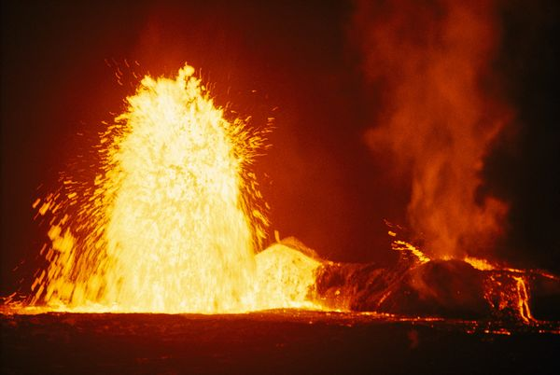
Chapter II
They soon got the the volcano city, volco

Slide 20
Who are you lot
I am hunt,this is demisewan and reznor
What is your reson to come
We are in search of warriors to help find the chaos stones,to save our world

Slide 21
Well we are the strongest warriors in the city,and we have a few more for help if you need it
Thank you
No problem if its to save this planet then happy to help...
What's that egg in your hand

Slide 22
Its a kuribo egg
Is it powerful
Yes it is actully,and around us it could be most powerful warriors in all of this city,and around you three mewthrees, you could show it right and wrong and how to use its power
Could i please have a look..

Slide 24
done
kuribo
It looks so cute..
Its known for that

Slide 25
Thank you
No prob
Sorry we never had a proper introduction,i’m laveon,thats weavile and pamero...and the shaman will come soon

Slide 26
What is this
Are you shaman nero
yes
We need you in our team
If my team have agreed i shall too, please give me your brief later,you need fighters

Slide 27
We need to go
Got it
Give me the briefing on the way

Slide 28
Thanks for watching Chaos stones vol 1,every volume is two episodes

